Slide 1
6.1 Unique Aspects of Ship Structures
  Ships are BIG!
  Three dimensional complex shape.
  Multi-Purpose Support Structure and Skin.
  Ships see a variety of dynamic and random loads.
  Ships operate in a wide variety of
  environments.

Slide 2
6.2 Ship Structural Load
Distributed Forces ; weight & buoyancy
Resultant weight force due to
the distributed weight
G
WL
B
Result Buoyancy force due to
the distributed buoyancy
< Floating Body in Static Equilibrium>
Two forces are equal in magnitude.
The centroid of the forces are vertically in line.

Slide 3
Distributed Forces
Distributed Buoyancy
- Buoyant forces can be considered as a distributed force.
50 ft
barge
2 LT/ft
uniformly
distributed
force

Slide 4
Distributed Forces
Distributed Weight
Weight of ship can be presented as a distributed force.
Case I : Uniformly distributed weight
2 LT/ft
50 ft
barge
2 LT/ft

Slide 5
Distributed Forces
Distributed Weight
- Case II : Non-uniformly distributed weight
4 LT/ft
10ft
2 LT/ft
2 LT/ft
1 LT/ft
1 LT/ft
50 ft
barge
2 LT/ft
w_{FB} = F_{B}/L (distributed load = F_{B}/length)
w_{FB} = 100LT = 2 LT/ft
50ft

Slide 6
Shear Stress
Shear stress present at points P, Q, R, S & T due to unbalanced forces
at top and bottom.
Load diagram can be drawn by summing up the distributed force vertically.
4 LT/ft
2 LT/ft
2 LT/ft
1 LT/ft
1 LT/ft
O
P
Q
R
S
T
2 LT/ft
O
P
Q
R
S
T
Load Diagram
2LT/ft
1LT/ft
P
1LT/ft
Shear Force at point P

Slide 7
Shear Stress
Maximum shear stresses occur where the load diagram crosses
the x-axis (or equals 0).
2 LT/ft
O
P
S
T
Load
Diagram
Q
R
1 LT/ft
1 LT/ft
+10 LT
Shear
Diagram
-10 LT

Slide 8
Shear Stress
How to Reduce Shear Stress of ship
To change the underwater hull shape so that buoyancy
distribution matches that of weight distribution.
- The step like shape is very inefficient with regard to
the resistance.
- Since the loading condition changes every time, this method
is not feasible.
To concentrate the ship hull strength in an area where large
shear stress exists . This can be done by
- using higher strength material
- increasing the cross sectional area of the structure.

Slide 9
Longitudinal Bending Stress
Longitudinal Bending Moment and Stress
Uneven load distribution will produce a longitudinal
Bending Moment.
Bending Moment
- Buoyant force concentrates at bow and stern.
- Weight concentrates at middle of ship.
The longitudinal bending moment will create a significant
stress in the structure called bending stress.

Slide 10
Longitudinal Bending Stress
A ship has similar bending moments, but the buoyancy and many loads are distributed over the entire hull instead of just one point.
The upward force is buoyancy and the downward forces are weights.
Most weight and buoyancy is concentrated in the middle of a ship, where the volume is greatest.

Slide 11
Longitudinal Bending Stress
Sagging
Weather deck : compression
Bending
Moment
Stern
Keel : tension
Bow
Hogging
Weather deck : tension
Stern
Bow
Bending
Moment
Keel : compression

Slide 12
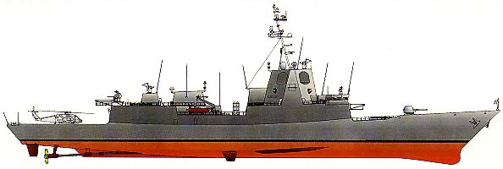
Longitudinal Bending Stress
Sagging & Hogging on Waves
Sagging condition
Crest
Crest
Trough
Buoyant force is greater at wave crests.
Hogging condition
Crest
Trough
Trough

Slide 13
Longitudinal Bending Stress
The longitudinal bending moment creates a significant
structural stress called the bending stress
Where:
M = Bending Moment
I = 2nd Moment of area of the cross section
y = Vertical distance from the neutral axis
= tensile (+) or compressive(-) stress

Slide 14
Longitudinal Bending Stress
Quantifying Bending Stress
y
Sagging condition
Compression
A
y
A
B
B
Tension
Neutral Axis
Bending Stress :
M : Bending Moment
I : 2nd Moment of area of the cross section
y : Vertical distance from the neutral axis
: tensile (+) or compressive(-) stress

Slide 15
Longitudinal Bending Stress
Quantifying Bending Stress
Hogging condition
y
Tension
A
A
B
Compression
B
Neutral Axis
Neutral Axis : geometric centroid of the cross section or
transition between compression and tension

Slide 16
Longitudinal Bending Stress
Example :Bending Stress of Ship Hull
Stern
Deck
Bow
A
NeutralAxis
B
Keel
cross
section
Tickness
A
Deck : Compression
Keel : Tension
B
Ship could be at sagging condition even in calm water .
Generally, bending moments are largest at the midship area.

Slide 17
Longitudinal Bending Stress
Example :Bending Stress of Ship Hull
Stern
Deck
Bow
Neutral Axis
A
B
Keel
cross
section
Tickness
y
A
N.A.
This ship has lager bending
stress at keel than deck.
Keel
B

Slide 18
Longitudinal Bending Stress
Reducing the Effect of Bending stress
Bending moment are largest at amidship of a ship.
Ship will experience the greatest bending stress at the deck
and keel.
The bending stress can be reduced by using:
- higher strength steel
- larger cross sectional area of longitudinal structural elements

Slide 19
Longitudinal Bending Stress
Hull Structure Interaction
Bending stress at the superstructure is large because of its
distance from the neutral axis.
In Sagging or Hogging condition, severe shear stresses between
deck of hull and bottom of the superstructure will be created.
This shear stresses will cause crack in area of sharp corners
where the hull and superstructure connect.
This stress can be reduced by an Expansion Joint

Slide 20
Longitudinal Bending Stress
Expansion Joint
Compression or
Tension on bottom
Compression or Tension on deck
By using Expansion Joint, the super structure will be
allowed to flex along with the hull.

Slide 21
Other Loads
Hydrostatic Loads
Loading associated with hydrostatic pressure
Hydrostatic Loads are considerable in submarines
Hydrostatic pressure :
Torsional Loads
Torsional Loads of hull are often insignificant
They can have effect on ships with large opening(s) in their
weather deck. (e.g., research vessels)

Slide 22
Other Loads
Weapon Loads
Loading due to explosion of weapons or shock impact, both in air and underwater
Naval Vessel should resist these forces
Naval vessel will often go through a series of shock trials during initial sea trials.

Slide 23
Example Problem
4LT/ft
2LT/ft
3LT/ft
20ft
20ft
30ft
10ft
20ft
A
B
C
D
100ft
A 100ft long box shaped barge has an empty weight distribution of 2LT/ft. What is the total buoyant force floating the empty barge in calm water?
The barge is then loaded with the additional cargo weight distribution shown above. What is the buoyant force distribution in calm water for the loaded barge?
At which point, (A, B, C or D) is the barge under the greatest shear stress?
Is the barge in a hogging or sagging condition?
If a wave hits which peaks at the center of the barge and troughs at the ends, is the condition above mitigated or exacerbated?

Slide 24
Example Answer
4LT/ft
2LT/ft
3LT/ft
20ft
20ft
30ft
10ft
20ft
A
B
C
D
100ft
Load Diagram
0.1LT/ft
2.1LT/ft
1.1LT/ft
1.9LT/ft
1.9LT/ft
F_{B Total Empty}=100ft×2LT/ft=200LT
F_{B Total Loaded}=200LT+20ft×2LT/ft+
30ft×4LT/ft+10ft×3LT/ft=390LT
F_{B Dist’n}=390LT/100ft=3.9LT/ft
Point A & D: Load Diagram Crosses X- Axis
Ends curling up - Sagging
(Mitigated by providing additional support at center of barge)

Slide 25
6.3 Ship Structure
Structural Components
Girder
- High strength structure running longitudinally
Keel
- Large center plane girder
- Runs longitudinally along the bottom of the ship
Plating
- Thin pieces enclosing the top, bottom and side of structure
- Contributes significantly to longitudinal hull strength
- Resists the hydrostatic pressure load (or side impact)
Frame
- A transverse member running from keel to deck
- Resists hydrostatic pressure, waves, impact, etc

Slide 26
Ship Structure
Structural Components
Floor
- Deep frame running from the keel to the turn of the bilge
- Frames may be attached to the floors
(Frame would be the part above the floor)
Longitudinal
- Girders running parallel to the keel along the bottom
- Intersects floors at right angles
- Provides longitudinal strength

Slide 27
Ship Structure
Structural Components
Stringer
- Girders running along the sides of the ship
- Typically smaller than a longitudinal
- Provides longitudinal strength
Deck Beams
- Transverse member of the deck frame
Deck Girder
- Longitudinal member of the deck frame
(deck longitudinal)

Slide 28
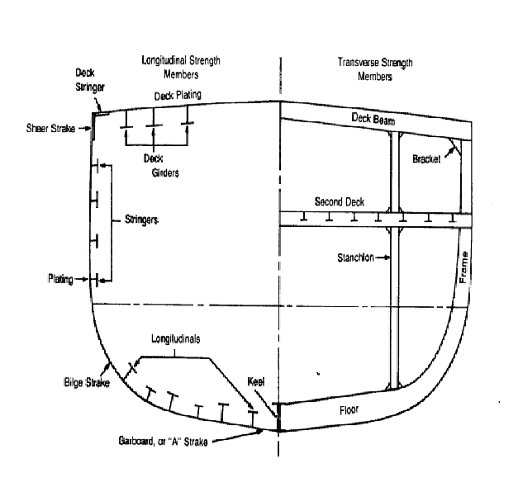

Slide 29
Framing System
Increase ship’s strength by:
- Adding framing elements more densely
- Increasing the thickness of plating and structural
components
All this will increase cost, reduce space utilization and
allow less mission-related equipment to be added
Optimization
Longitudinal Framing System
Transverse Framing System
Combination of Framing System

Slide 30
Framing System
Longitudinal Framing System
Longitudinal Framing System :
- Longitudinals are spaced frequently but shallower
- Frames are spaced widely
- Keel, longitudinals, stringers, deck girders, plates
Primary role of longitudinal members : to resist the
longitudinal bending stress due to sagging and hogging.
A typical wave length in the ocean is 300ft. Ships of this length
or greater are likely to experience considerable longitudinal
bending stress.
Ship that are longer than about 300ft (long ship) tend to have a
greater number of longitudinal members than transverse
members.

Slide 31
Framing System
Transverse Framing System
Transverse Framing System :
- Longitudinals are spaced widely but deep.
- Frames are spaced closely and continuously
Transverse members : frame, floor, deck beam, plating
Primary role of transverse members : to resist hydrostatic
loads.
Ships shorter than 300ft and submersibles

Slide 32
Framing System
Combined Framing System
Combination of longitudinal and transverse framing system
Purpose :
- To optimize the structural arrangement for the expected
loading
- To minimize the cost
Typical combination :
- Longitudinals and stringers with shallow frame
- Deep frame every 3rd or 4th frame

Slide 33
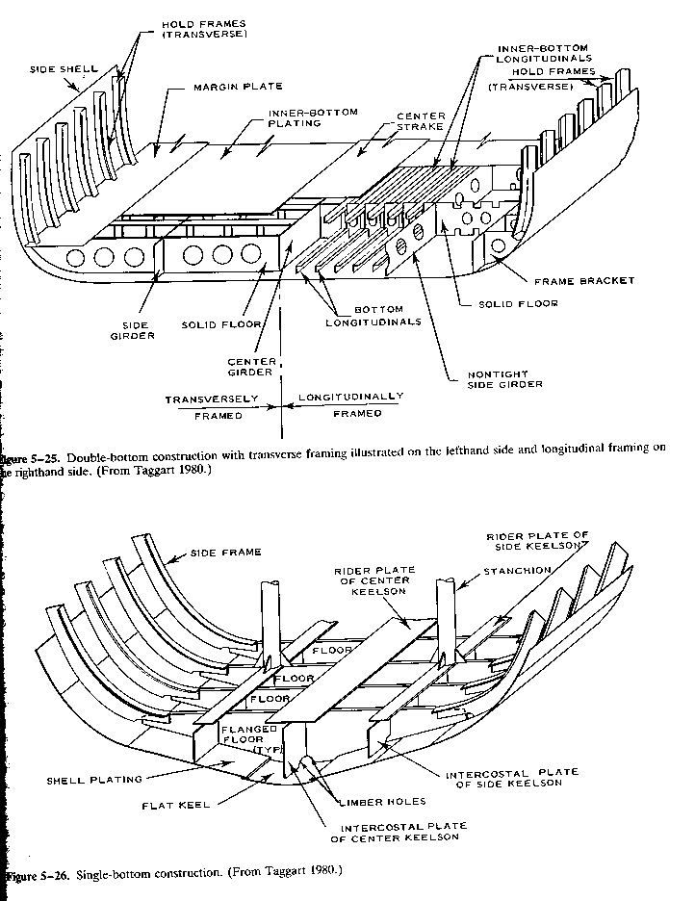

Slide 34
Double Bottoms
Two watertight bottoms with a void space in between to withstand
- the upward pressure
- bending stresses
- bottom damage by grounding and underwater shock.
The double bottom provides a space for storing
- fuel oil
- ballast water & fresh water
- smooth inner bottom which make it easier to arrange cargo &
equipment and clean the cargo hold.

Slide 35
Watertight Bulkheads
Large bulkhead which splits the the hull into separate sections
Primary role
- Stiffening the ship
- Reducing the effect of damage
The careful positioning the bulkheads allows the ship to fulfill
the damage stability criteria.
The bulkheads are often stiffened by steel members in the
vertical and horizontal directions.

Slide 36
6.4 Modes of Structural Failure
1. Tensile or Compressive Yield
Slow plastic deformation of a structural component due to an
applied stress greater than yield stress
To avoid the yield, Safety factors are considered for ship
constructions.
Safety factor = 2 or 3
(Maximum stress on ship hull will be 1/2 or 1/3 of yield
stress.)

Slide 37
Modes of Structural Failure
2. Buckling
Substantial dimension changes and sudden loss of stiffness
caused by the compression of long column or plate
Buckling load on ship : cargo, waves, impact loads, etc.
Ex :
Deck buckling : by sagging or hogging, loading on deck
Side plate buckling : by waves, shock, groundings
column bucking : by excessive axial loading

Slide 38
Modes of Structural Failure
3. Fatigue Failure
The failure of a material from repeated application of stress
such as from vibration
Endurance limit : stress below which will not fail from fatigue
Fatigue failure is affected by
- material composition (impurities, carbon contents,
internal defects)
- surface finish
- environments (corrosion, salinities, sulfites, moisture,..)
- geometry (sharp corners, discontinuities)
- workmanship (welding, fit-up)
Fatigue generally creates cracks on the ship hull.

Slide 39
Modes of Structural Failure
4. Brittle Fracture
A sudden catastrophic failure with little or no plastic deformation
Brittle fracture depends on
Material: Low toughness & high carbon material
Temperature: Material operating below its transition temperature
Geometry: Weak point for crack : sharp corners, edges
Type / Rate of Loading: Tensile/impact loadings are worse

Slide 40
Modes of Structural Failure
5. Creep
The slow plastic deformation of material due to continuously
applied stresses that are below its yield stress.
Creep is not usually a concern in ship structures.

Slide 41
Example Problem:
Identify the following ship structural elements:
____________
Strength Members
  ____
  __________
  _______
  __________
  _____
__________
Strength Members
  _____
  _____
  _________
  _______

Slide 42
Example Answer:
Identify the following ship structural elements:
Transverse
Strength Members
  Frame
  Floor
  Deck Beam
  Plating
Longitudinal
Strength Members
  Keel
  Longitudinal
  Stringer
  Deck Girder
  Plating

Slide 43
Example Problem
For the following components, what is the primary failure mode of concern and how do we address that concern?
  Thick low carbon steel nuclear reactor pressure vessel
  Aluminum airplane wings where they join the fuselage
  Weapons handling gear
  Steel water tower legs

Slide 44
Example Answer
Thick low carbon steel nuclear reactor pressure vessel
  Brittle Fracture
    Operate primarily above transition temperature
    Minimize stresses when below transition temperature
Aluminum airplane wings where they join the fuselage
  Fatigue
    Highly polished surfaces
    Frequent inspections
    Periodic replacements
Weapons handling gear
  Tensile/compressive yield
    Limit loads
    Perioidic weight tests
    Visual inspections prior to use
Steel water tower legs
  Buckling/instability
    Limit loads
    Cross brace

Slide 45
Review of Chapters 4-6
Chapter 4: Stability
Chapter 5: Properties of Naval Materials
Chapter 6: Ship Structures
Review Equation & Conversion Sheet

Slide 46
Chapter 4: Stability
Internal Righting Moment
Curve of Intact Statical Stability
Stability Characteristics from Curve
Effect of Vertical Motion of G on GZ
Effect of Transverse Motion of G on GZ
Damage Stability
Free Surface Correction
Metacentric Height and Stability

Slide 47
Chapter 4
RM=GZ Δ=GZ F_{B}
GZ_{eff}=G₀Z₀-G₀G_{v}sinΦ-G_{v}G_{t}cosΦ-FSCsinΦ
(GZ_{eff}=G₀Z₀-KGsinΦ-TCGcosΦ-FSCsinΦ)
FSC=ρ_{t}i_{t}/(ρ_{s}V_{s})
i_{t}=lb³/12 (for rectangular tank)
GM_{eff}=GM-FSC=KM-KG-FSC
GZ=GMsinΦ (for small angles)
Damage Stability analyzed using added weight method
Positive, Neutral, Negative Stability

Slide 48
Curve of Intact Statical Stability
Righting Arm
(GZ)
Max Righting Arm (GZmax)
(×Δ=Max Righting Moment)
Angle of GZmax
Dynamical
Stability
=Δ∫GZdφ
Slope~tender/stiff
Heeling Angle
Range of Stability

Slide 49
Chapter 5: Properties of Naval Materials
Classifying Loads
Stress and Strain
Stress-Strain Diagrams and Material Behavior
Material Properties
Non-Destructive Testing
Other Engineering Materials

Slide 50
Chapter 5
Stress: σ=F/A (lb/in², psi or ksi)
Elongation: e=L-L₀; Strain: ε=e/L₀ (ft/ft)
Elastic Modulus: E=σ/ε (lb/in², psi, ksi)
UTS
Elastic
Region
Strain
Hardening
σ_{y}
Plastic Region
Fracture
σ
Stress
Material
Toughness
Slope=E
ε Strain
Stress/Strain Diagram

Slide 51
Chapter 5
Ductile to Brittle Transition:
Fatigue Behavior:
Charpy
(Impact)
Toughness
(in-lbs)
Steel
Ductile
Behavior
σ
Stress
(psi)
Brittle
Behavior
Endurance Limit
Transition
Temperature
Aluminum
Cycles N
Temperature(°F)

Slide 52
Chapter 5
NDT
  External: VT, PT, MT
  Internal: RT, UT, Eddy Current
  Op tests: Hydro, Weight/Load

Slide 53
Chapter 6: Ship Structures
Unique Aspects of Ship Structures
Ship Structural Loads
Ship Structure
Modes of Failure

Slide 54
Chapter 6
4LT/ft
Distributed Forces
  Distributed Weight
  Distributed Buoyancy
  Distribution×Distance=Total
    1LT/ft×6ft+4LT/ft×3ft=18LT
    2LT/ft×9ft=18LT
Shear Stress
  Localized bending moment
  Sagging, Hogging
1LT/ft
1LT/ft
2LT/ft
2LT/ft
1LT/ft
1LT/ft

Slide 55
Chapter 6: Ship Structural Components
Longitudinal Strength Members
  Keel
  Longitudinal
  Stringers
  Deck Girders
  Plating
Transverse Strength Members
  Frame
  Floor
  Deck Beams
  Plating
Stanchion

Slide 56
Chapter 6: Modes of Structural Failure
Tensile or Compressive Yield
  Exceed Yield Stress
Buckling
  Bowing induced by
  longitudinal load on
  slender structure
Stress
σ_{y}
Strain

Slide 57
Chapter 6
Fatigue Failure
Brittle Fracture
  Material
  Temperature
  Geometry
  Rate of Loading
Steel
σ
Stress
(psi)
Endurance Limit
Aluminum
Cycles N
Brittle
Charpy
(Impact)
Toughness
(in-lbs)
Ductile
Behavior
Stress
Ductile
Brittle
Behavior
Transition
Temperature
Strain
Temperature(°F)

Slide 58
Summary
Equation Sheet
Assigned homework problems
Homework problems not assigned
Example problems worked in class
Example problems worked in text

